Slide 1

Überblick Microsoft Cloud Adoption Framework
Plan

Slide 2
Plan
An iterative process that supports your business … as it evolves
Govern
Manage
Define strategy
Adopt
Ready

Slide 3
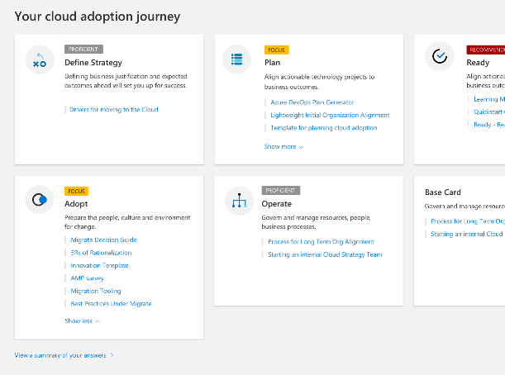
Before we begin…..
Let’s take a few minutes to capture the current state of your cloud adoption using the “Cloud Journey Tracker”.
Assess your cloud journey by reviewing the strategy and plan template.

Slide 4
Plan
Define strategy
Plan
Ready
Adopt
Cloud adoption plans convert the aspirational goals of the cloud adoption strategy into actions. It will help guide technical efforts, in alignment with the business strategy.
Govern
Manage
Digital estate
Rationalization: inventory
Quantitative analysis: asset optimized and sized properly
Qualitative analysis: operational process
Initial organization alignment
Cloud Strategy Team
Business IT: requirements and needs
IT management operations: traditional IT
Governance: executive sponsor, finance, business leadership, legal, security, HR
Cloud platform vendor: account success team
Cost management
IT-business alignment
Governance MVP
Skill readiness plan
Organizational readiness
Governance and security alignment
Initial organization alignment
Building technical skills: business/technical, and certifications
Change management guidance
Cloud adoption plan
5R strategy: rehost, refactor, rearchitect, rebuild, replace
Infrastructure migration: VM, server, database focus
Application innovation: born in the cloud applications, APIs
Data-driven innovation: Focus on data consolidation and analysis

Slide 5
Plan | Rationalize digital estate
Cloud rationalization is the process of evaluating assets to determine the best approach to hosting them in the cloud (public or hybrid)
Rationalization can take place using an incremental approach or ‘Power of 10’ where the cloud strategy team selects the first 10 applications to be migrated which are a mix of simple and complex workloads; (recommended approach)
The output of a rationalization effort is a prioritized backlog of all assets that are affected by the chosen transformation.
Use costing models from your chosen cloud provider to forecast costs for your prioritized backlog; for Azure, we have pricing tools like Azure Migrate, Azure pricing calculator and Azure cost management. Ensure that hybrid is incorporated into the costing models.

Slide 6

Top Down – Application Assessment
32 Evaluation Criteria Items
Based on 6 Evaluation Aspects
Activities and Associated Cloud Benefits
Workload
Architecture
Financial
Risk
Operations
Security
Cloud Assessment Framework
High
Replace (SaaS)
Rebuild
(PaaS)
Rebuild (PaaS)
Level of Difficulty
Rehost (IaaS)
Refactor (Hybrid)
Replace
(SaaS)
Rehost
(IaaS)
Low
Operational
Degree of Benefits
Strategic

Slide 7
Top Down - Prioritize the catalog
Architecture
User Interfaces
Complexity
Authentication
Data Structure
Latency
Coupling
Life expectancy
Financial
Operating costs
Relative difficulty
of the migration
Degree of benefits
App Valuation
Security
Jurisdiction
Regulatory
Data classification
Workload Type
Compute Intensity
Type of users
Scalability
Elasticity required
Risk
Business Impact
Technical
Operations
Business continuity
Operations
Monitoring
Tools/Integration

Slide 8
Plan
Define strategy
Plan
Ready
Adopt
Cloud adoption plans convert the aspirational goals of the cloud adoption strategy into actions. It will help guide technical efforts, in alignment with the business strategy.
Govern
Manage
Digital estate
Rationalization: inventory
Quantitative analysis: asset optimized and sized properly
Qualitative analysis: operational process
Initial organization alignment
Cloud Strategy Team
Business IT: requirements and needs
IT management operations: traditional IT
Governance: executive sponsor, finance, business leadership, legal, security, HR
Cloud platform vendor: account success team
Cost management
IT-business alignment
Governance MVP
Skill readiness plan
Organizational readiness
Governance and security alignment
Initial organization alignment
Building technical skills: business/technical, and certifications
Change management guidance
Cloud adoption plan
5R strategy: rehost, refactor, rearchitect, rebuild, replace
Infrastructure migration: VM, server, database focus
Application innovation: born in the cloud applications, APIs
Data-driven innovation: Focus on data consolidation and analysis

Slide 9


Why change?
Traditional
Dedicated infrastructure for each application
Purpose-built hardware
Distinct infrastructure and operations teams
Customized processes and configurations
Physical access and manual labor
Modern
Loosely coupled apps and micro-services
Industry-standard hardware
Service (DevOps) / configuration as code
Standardized processes and configurations
Virtual access and systemic automation
Servers
Services

Slide 10
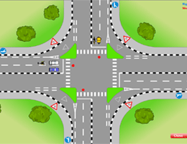
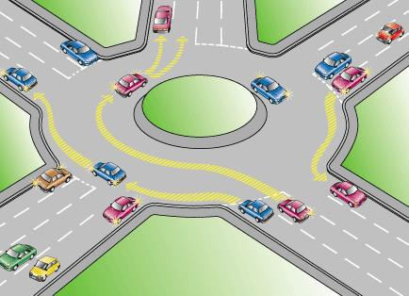
The paradigm shift
Enforce/Control
Enable/Support
Controlled & central responsibility
Freedom & delegated responsibility

Slide 11


Plan | Initial organization alignment
Implementing Cloud adoption plan requires some initial alignment of different stakeholders who will make the plan a reality.
Cloud Adoption Team
Cloud Governance Team
Speed vs. Control
Create a balance between speed or moving quickly and control or reducing risks by have teams accountable for adoption and governance.
While cloud adoption team is required to execute cloud adoption tasks, governance team ensures processes and controls are implemented.

Slide 12
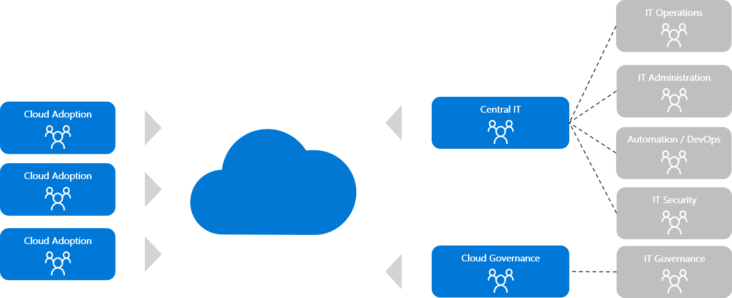
Next potential steps Central IT…

Slide 13
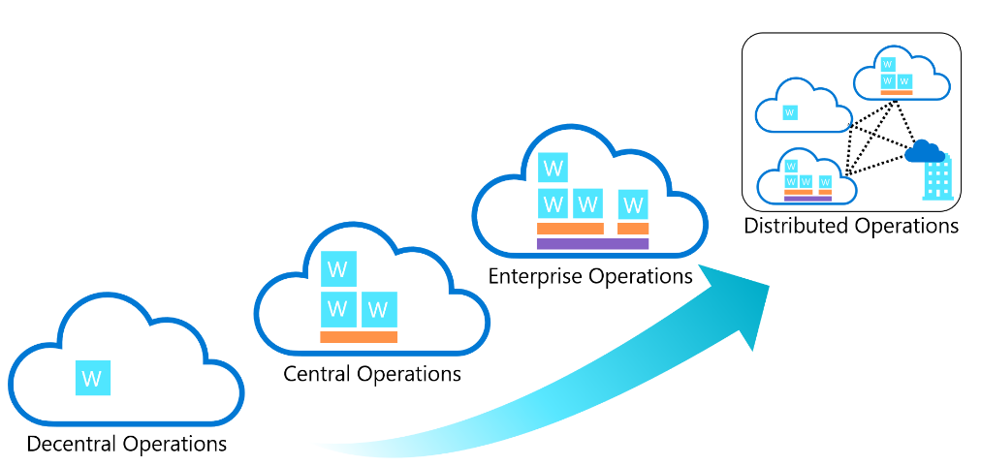
Compare common cloud operating models
Complexity

Slide 14
Plan
Define strategy
Plan
Ready
Adopt
Cloud adoption plans convert the aspirational goals of the cloud adoption strategy into actions. It will help guide technical efforts, in alignment with the business strategy.
Govern
Manage
Digital estate
Rationalization: inventory
Quantitative analysis: asset optimized and sized properly
Qualitative analysis: operational process
Initial organization alignment
Cloud Strategy Team
Business IT: requirements and needs
IT management operations: traditional IT
Governance: executive sponsor, finance, business leadership, legal, security, HR
Cloud platform vendor: account success team
Cost management
IT-business alignment
Governance MVP
Skill readiness plan
Organizational readiness
Governance and security alignment
Initial organization alignment
Building technical skills: business/technical, and certifications
Change management guidance
Cloud adoption plan
5R strategy: rehost, refactor, rearchitect, rebuild, replace
Infrastructure migration: VM, server, database focus
Application innovation: born in the cloud applications, APIs
Data-driven innovation: Focus on data consolidation and analysis

Slide 15
Plan | Skills readiness plan
Cloud computing is a technology shift, and a new set of skills are required to support cloud solutions.
Commoditized skills
Solution Manager
UI Designer UX Designer
Tester SDET
Developer
Application Operation & Support
Network Datacenter Engineer
Statistician Analyst
DBA Data Analyst
Relationship Manager
Trusted Advisor
Business Architect
Best use of assets
Process Engineer
Real-enough time
Engineering & DevOps
It works, build for monitoring self-healing
Edge/Wireless Networking
Secure, anywhere access
Cloud Architect
Secure, Anywhere access
Data Scientist
Business Insight
Information Architect
Trustworthy data
Strategic skills for the new era
1. Identify the gaps
2. Look across teams
3. Create an org-wide learning plan

Slide 16
Plan
Define strategy
Plan
Ready
Adopt
Cloud adoption plans convert the aspirational goals of the cloud adoption strategy into actions. It will help guide technical efforts, in alignment with the business strategy.
Govern
Manage
Digital estate
Rationalization: inventory
Quantitative analysis: asset optimized and sized properly
Qualitative analysis: operational process
Initial organization alignment
Cloud Strategy Team
Business IT: requirements and needs
IT management operations: traditional IT
Governance: executive sponsor, finance, business leadership, legal, security, HR
Cloud platform vendor: account success team
Cost management
IT-business alignment
Governance MVP
Skill readiness plan
Organizational readiness
Governance and security alignment
Initial organization alignment
Building technical skills: business/technical, and certifications
Change management guidance
Cloud adoption plan
5R strategy: rehost, refactor, rearchitect, rebuild, replace
Infrastructure migration: VM, server, database focus
Application innovation: born in the cloud applications, APIs
Data-driven innovation: Focus on data consolidation and analysis

Slide 17
Plan | Cloud Adoption Plan
Translate strategy and effort into an actionable cloud adoption plan.
Prerequisites: Confirm that all prerequisite steps have been completed before you create your plan.
Define and prioritize workloads: Prioritize your first 10 workloads to establish an initial adoption backlog.
Align assets: Identify which assets (proposed or existing) are required to support the prioritized workloads.
Review rationalization: Review rationalization decisions to refine adoption-path decisions: Migrate or Innovate.
Define iterations and releases: Iterations are the time blocks allocated to do work. Releases are the definition of the work to be done before triggering a change to production processes.
Estimate timelines: Establish rough timelines for release planning purposes, based on initial estimates.

Slide 18
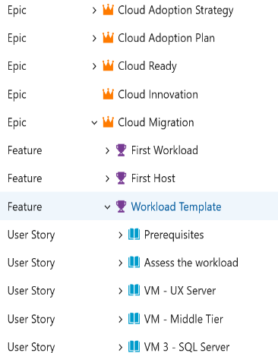
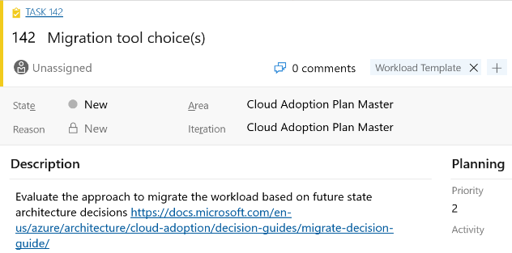
Azure DevOps cloud adoption plan generator
Leverage Azure DevOps to log and track your cloud adoption plan: aka.ms/adopt/plan

Slide 19

Next steps
Finalize the Strategy and Plan template
Take the Cloud Journey Tracker assessment & identify your cloud adoption needs
Build your cloud adoption plan
Deploy your cloud adoption plan with Azure DevOps
Choose your landing zone

